Slide 1
Landscaped Eco-System
A Local Area of Enjoyment

Slide 2
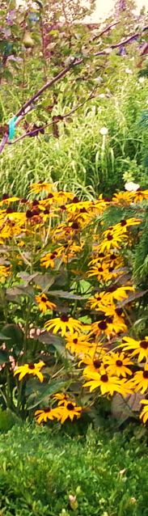
Overview
Landscape with Identified Components
4 Detailed Landscape Components
  Japanese Maple Dragon Red (Tree)
  Boxwood Green Gem (Shrub)
  Black-Eyed Susan (Flowering Plant)
  Robin (Animal)
4 Eco-system Improvements
  Automated Sprinkler System
  Add a Bird House
  Use a Cedar Mulch
  Install a Composter
Summary
Resources

Slide 3
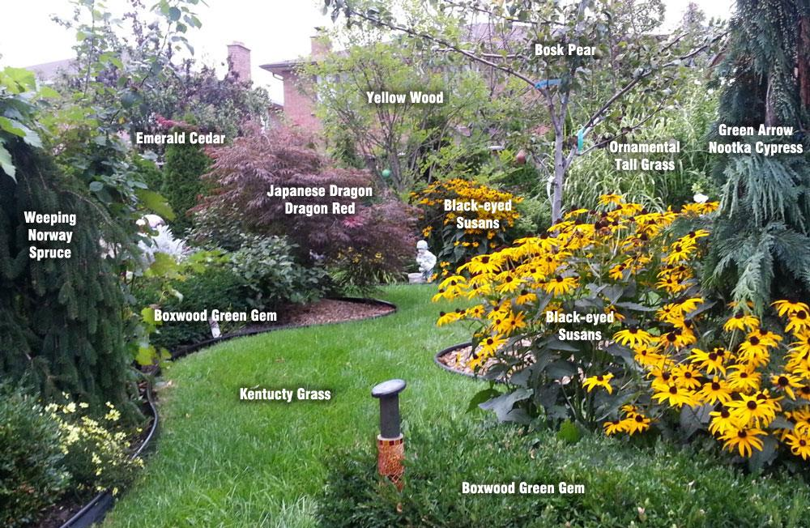
Landscape with Identified Components

Slide 4
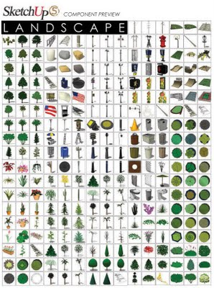
4 Detailed Landscape Components
Four major landscape components I selected are:
  Tree: Japanese Maple Dragon Red
  Shrub: Boxwood Green Gem
  Flowering Plant: Black-Eyed Susan
  Local Animal: Robin

Slide 5
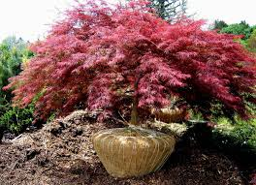
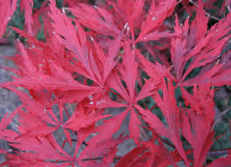
Japanese Maple Dragon Red
official name
major characteristics
life span and growth cycle
environment requirements
food and nourishment
maintenance and care

Slide 6
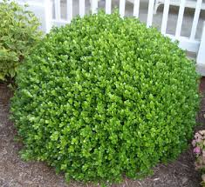
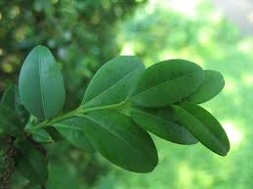
Boxwood Green Gem
official name
major characteristics
life span and growth cycle
environment requirements
food and nourishment
maintenance and care

Slide 7
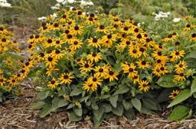
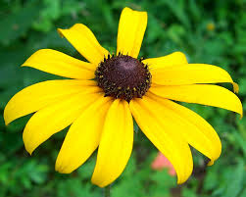
Black-Eyed Susan
official name
major characteristics
life span and growth cycle
environment requirements
food and nourishment
maintenance and care

Slide 8
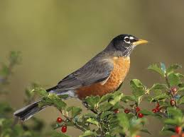
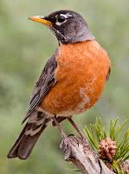
Robin
official name
major characteristics
life span and growth cycle
environment requirements
food and nourishment
maintenance and care

Slide 9

My 4 Eco-system Improvements
The following are my improvements for my selected landscaped eco-system:
  Automated Lawn Sprinkler System
  Add a Bird House
  Use a Cedar Mulch
  Install a Composter

Slide 10
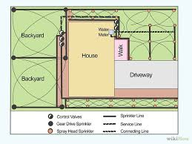
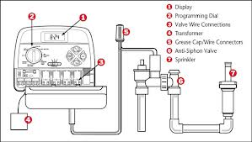
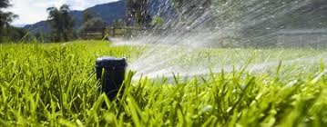
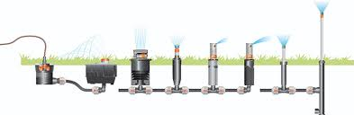
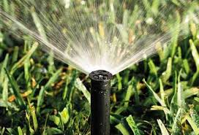
Automated Lawn Sprinkler System
general description
how it can help your eco-system
best way to implement

Slide 11
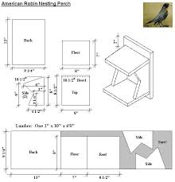
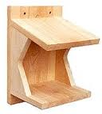
Add a Bird House
general description
how it can help your eco-system
best way to implement

Slide 12
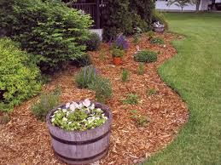
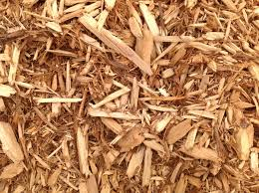
Use Cedar Mulch
general description
how it can help your eco-system
best way to implement

Slide 13
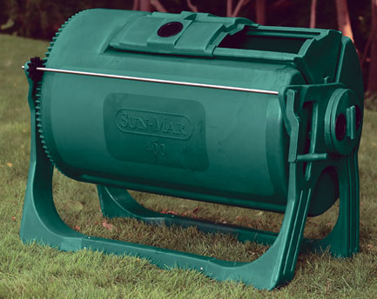
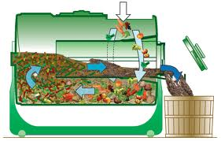
Install a Composter
general description
how it can help your eco-system
best way to implement

Slide 14
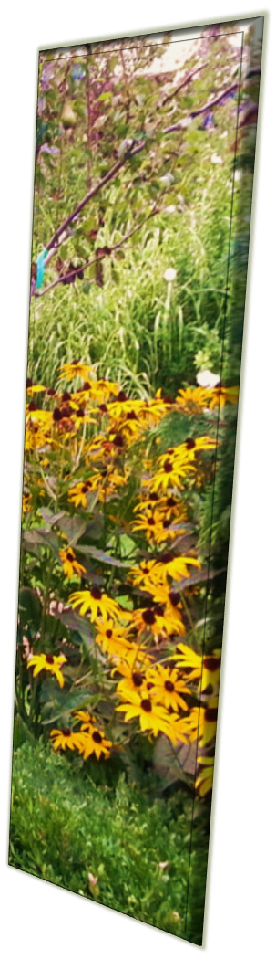
Summary
Looked at my selected Landscape eco-system
Described in detail 4 components from my selected eco-system landscape, as follows:
  Japanese Maple Dragon Red (Tree)
  Boxwood Green Gem (Shrub)
  Black-Eyed Susan (Flowering Plant)
  Robin (Animal)
Looked at 4 Eco-system Improvements that were important to implement:
  Automated Sprinkler System
  Add a Bird House
  Use a Cedar Mulch
  Install a Composter
Learned specific details of an eco-system and ways to improve

Slide 15
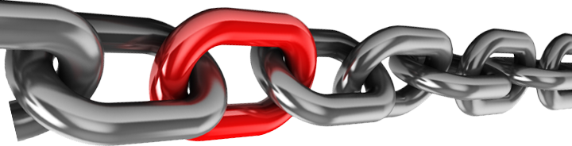
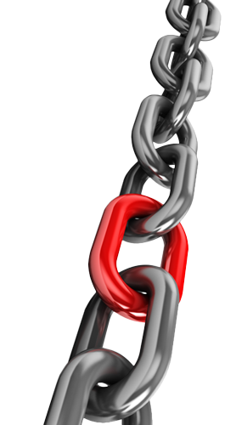
Resources
Web link 1
Web link 2
Web link 3
Web link 4
Web link 5
Web link 6
Web link 7
Web link 8

